Slide 1
Department Parent Meeting!

Slide 2
Intro Directors!

Slide 3
Mr. Timothy Jackubek
VISUAL AND PERFORMING ARTS CHAIR
THEATER CHAIR/TECHNICAL DIRECTOR
AUDITORIUM COORDINATOR
Technical Theater Class I-III
tjackubek@conroeisd.net
Office: 936-709-1288

Slide 4
Mrs. Heather Collins
DIRECTOR - LITTLE WOMEN (FALL SHOW)
DIRECTOR - UIL OAP
SPEECH COACH
SCRIPT CLUB
Theater Classes I-IV
hdcollins@conroeisd.net

Slide 5
Ms. Bonnie Dupuis
DIRECTOR - PUFFS (FALL SHOW)
DIRECTOR - UIL OAP
PRODUCER - Highlander Film Fest
SPEECH COACH
Theater Arts I - Freshman Campus
bdupuis@conroeisd.net

Slide 6
Mr. Matthew Peters
DIRECTOR - THE SOUND OF MUSIC
DIRECTOR - UIL OAP
SPEECH COACH
IMPROV COACH
Theater Arts 1 Class
Advanced Theatre Arts 1
Musical Theatre Class
Theatre Productions Class
mtpeters@conroeisd.net

Slide 7
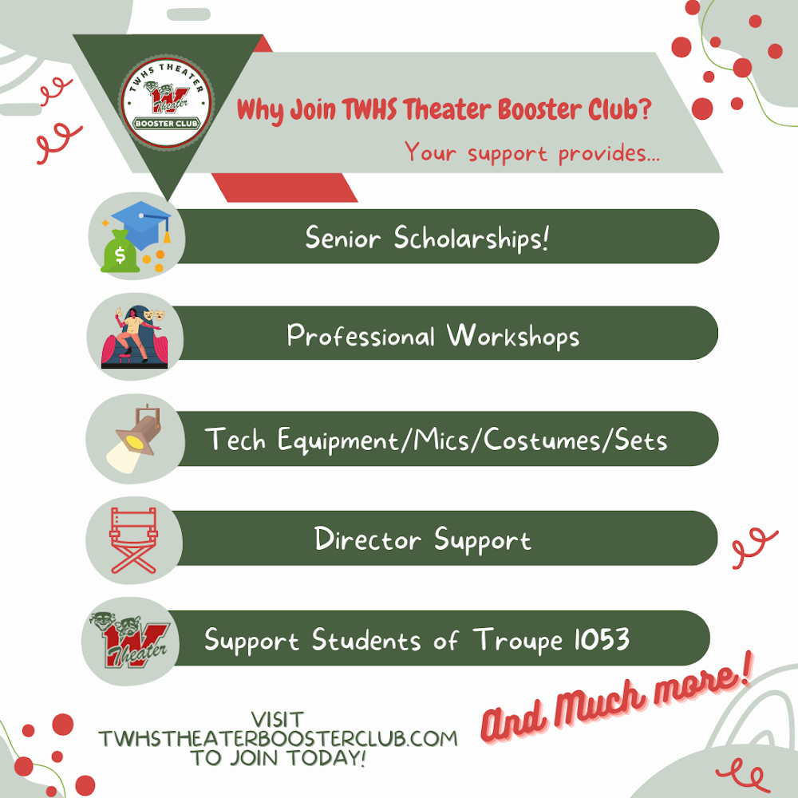
What Does TWHS Theater Booster Club Do?

Slide 8
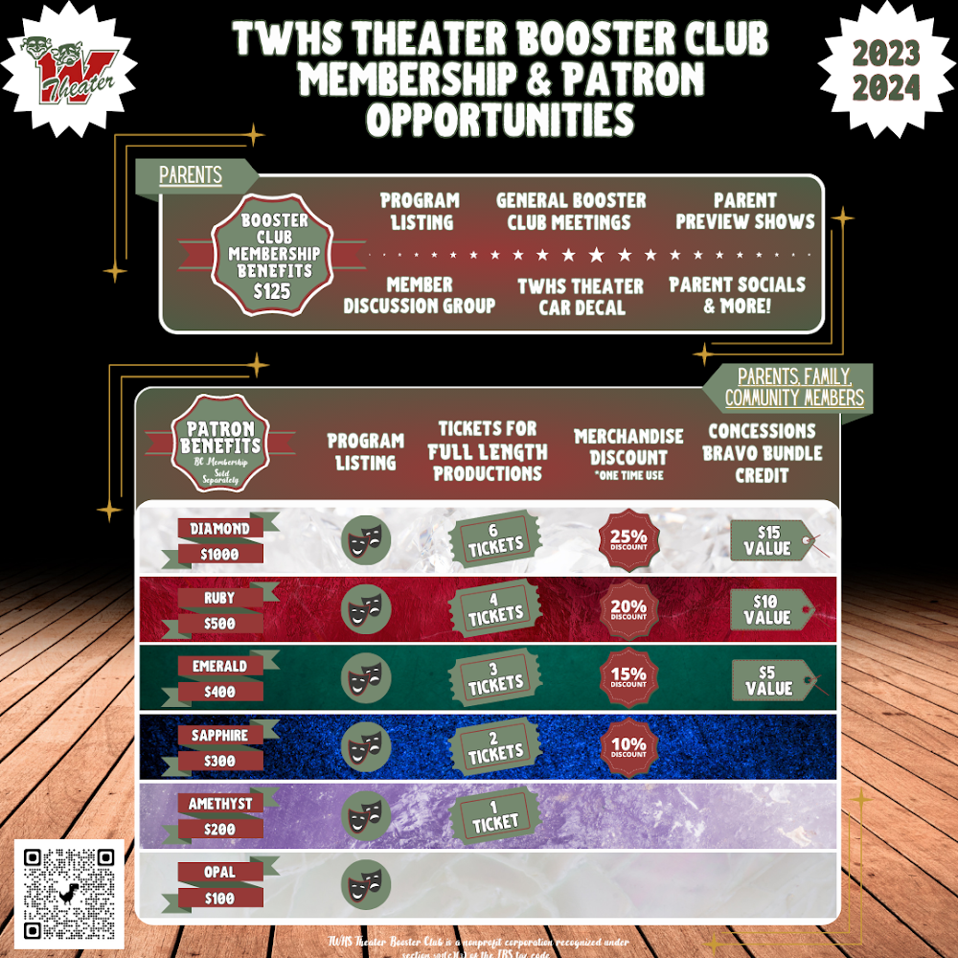
Join Us!
BC Membership is $125
Many levels of Patron Sponsorships in addition to Membership
Tickets/Merch Discounts & Concession/Bravo Bundle credits!

Slide 9
Community/Corporate Sponsors

Slide 10
How To Get Involved!

Slide 11
Helpful Info/Updates for Parents

Slide 12
Student Ads!
Open to everyone involved in the production!

Slide 13
Spirit Nights!

Slide 14
Support While You Shop
Kroger
Walmart Spark Good
Department Merch
Bravo Bundles

Slide 16
TWHS Theater Booster Club!
Connect with us!
Instagram:
@twhstheaterboosterclub
Facebook Page:
TWHS Theater Booster Club
Facebook Booster Club Members Group:
Invitation to sent after joining Booster Club
Website:
www.twhstheaterboosterclub.com

Slide 17
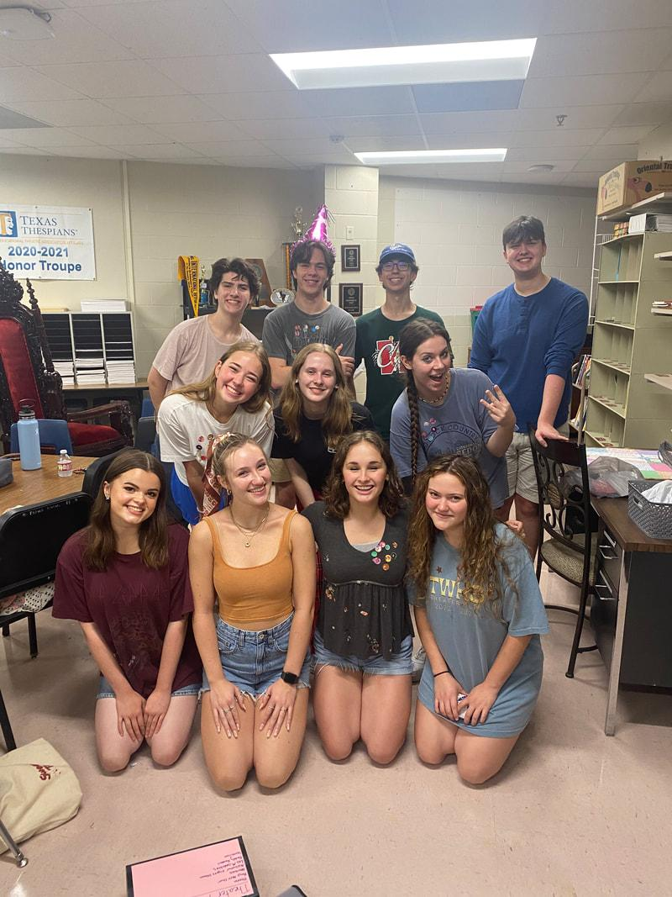
How we represent ourselves at school:
Shows:
Little Women
Puffs
The Sound of Music
UIL OAP
Cabaret
Film Fest
BB Musical
Classes:
Advanced Theater 1, Theater 1-4, Musical Theater 1 and 2, Theatrical Productions, Tech Theater 1-3
Clubs:
Script Club
Klub Korner and outreach

Slide 18
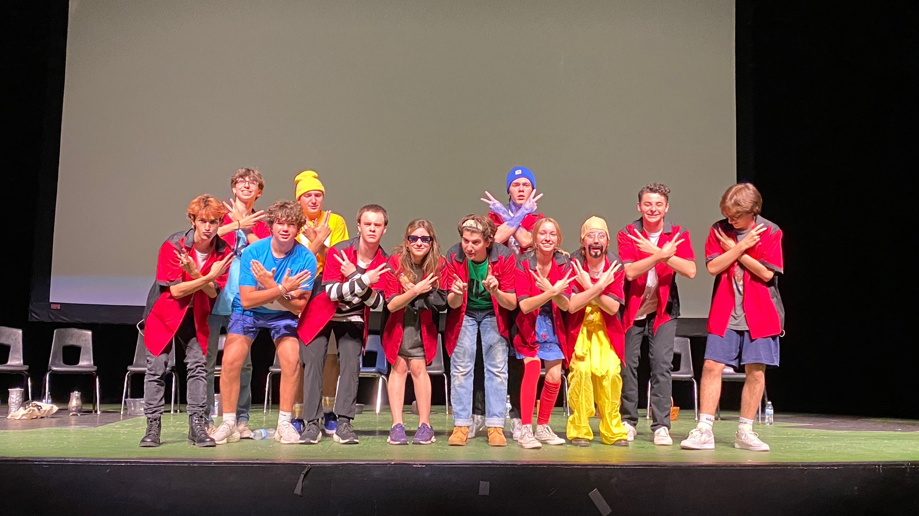
How we represent ourselves in the community
Volunteer Opportunities
Donation Drives
Improv
Department Outreach

Slide 19
How we represent ourselves in the state
TTSF
National qualifiers
Wide range of IEs
Advocacy
Support charities and organizations
Speech
Compete with other schools in tournaments and compete at TFA State

Slide 20
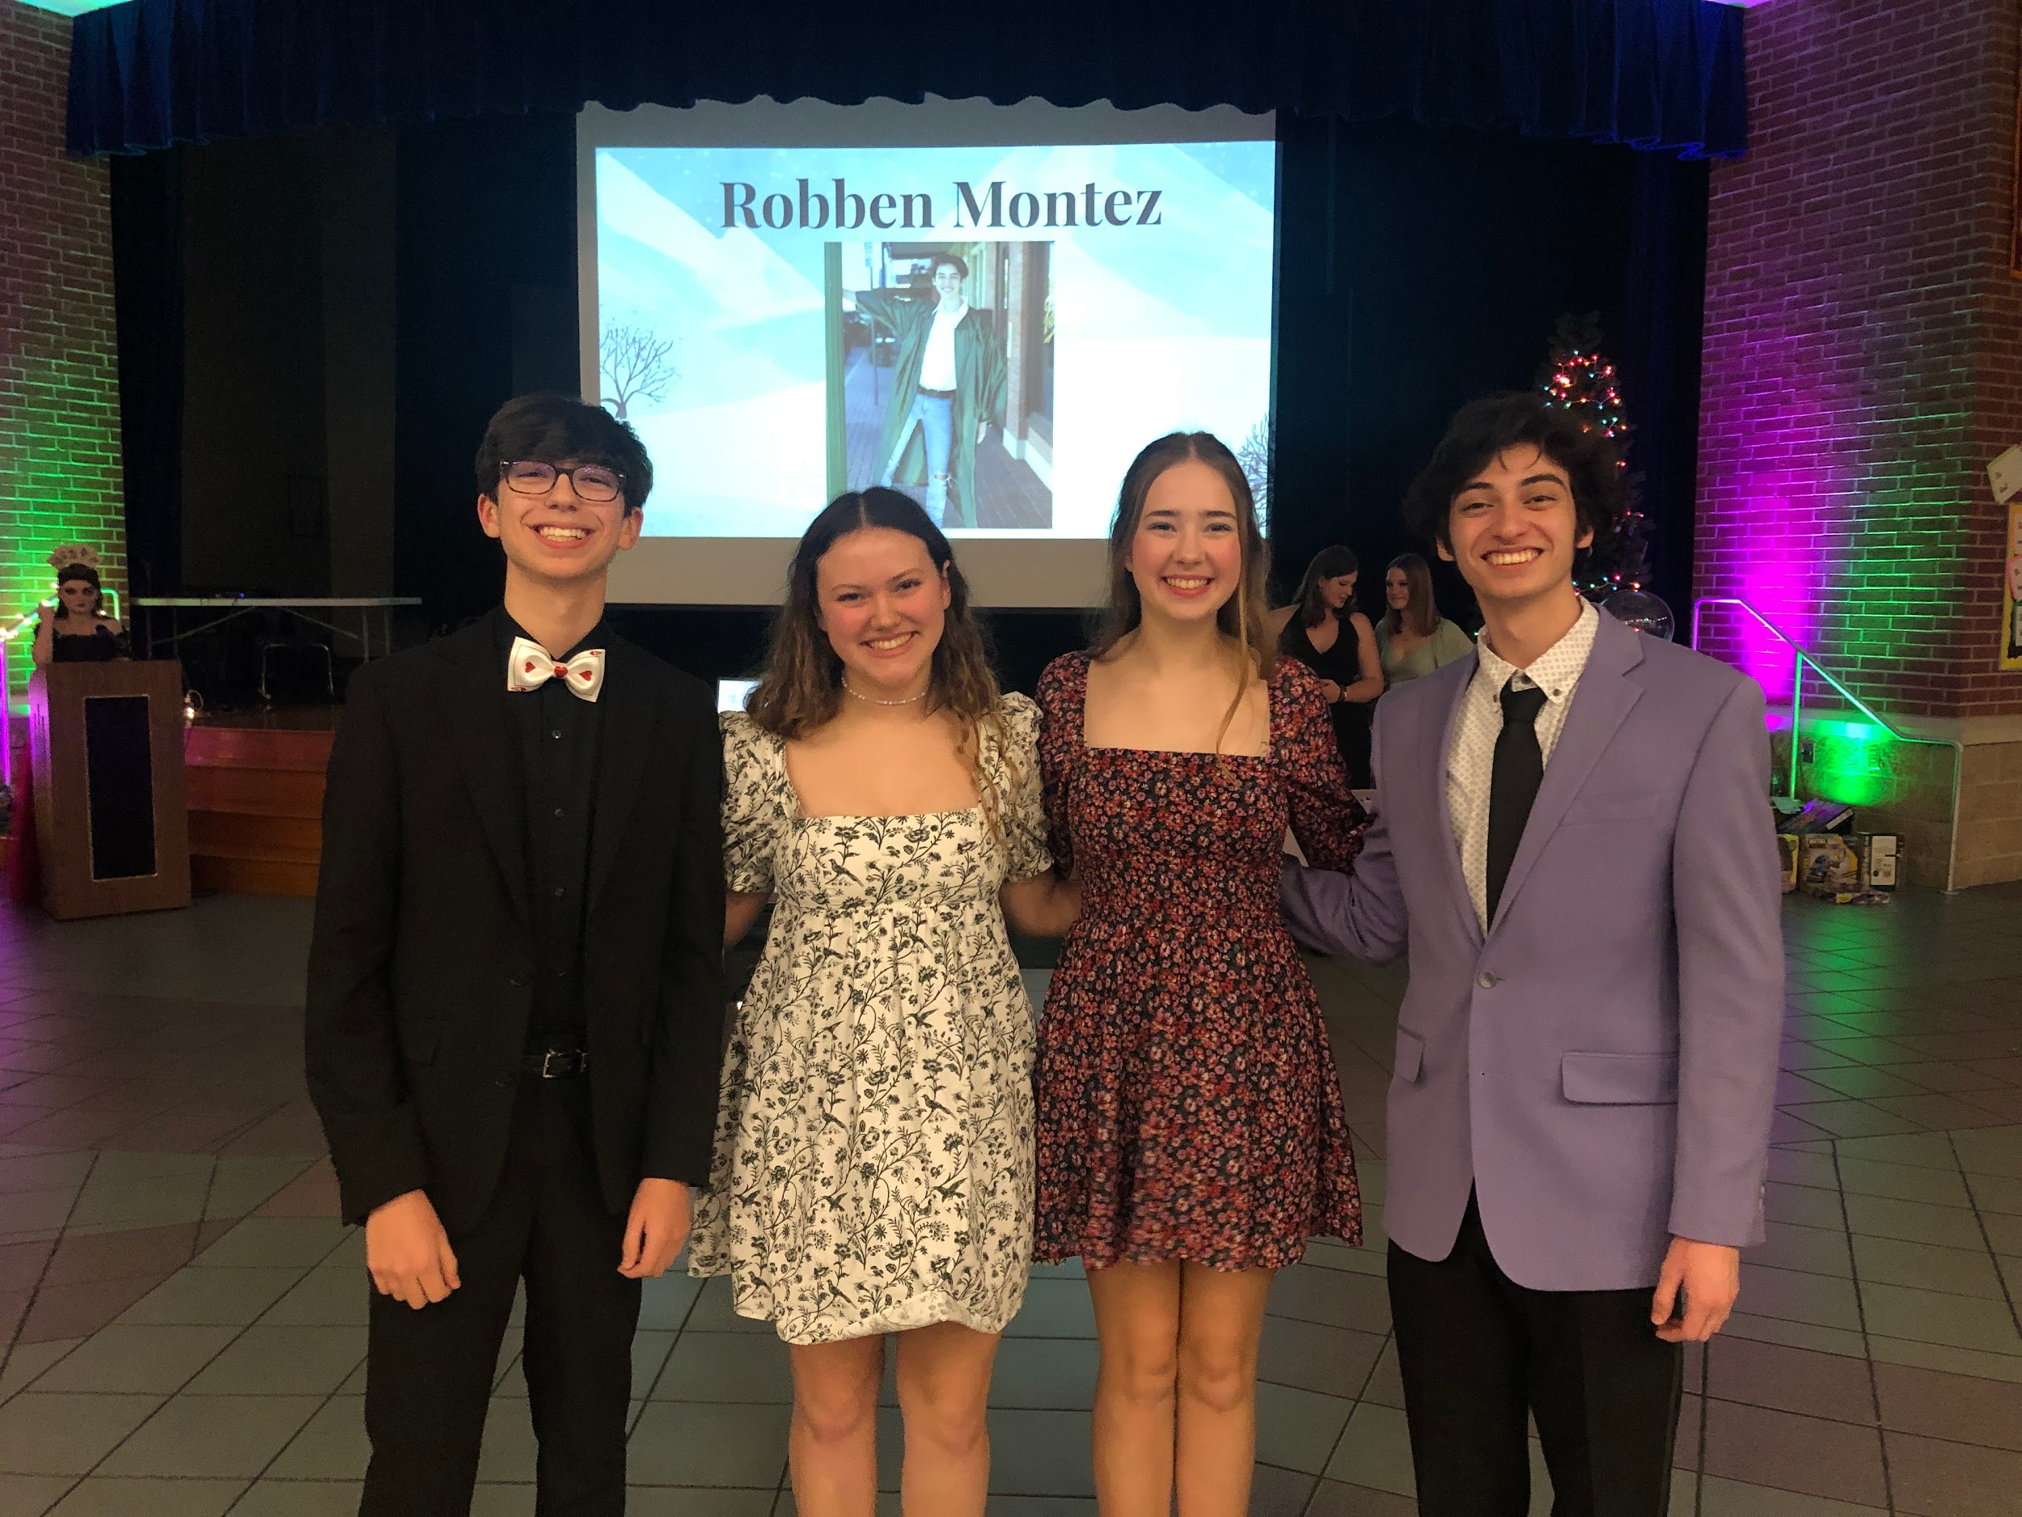
Thespian Points
What are points?
Ways to show participation in the department
Tech Heads= 5 points
Lead Actors= 8 points
Supporting Actors= 6 points
Ensemble= 4 points
Honor Levels:
Inducted= 10 points
Lettered= 50 points
Honored= 60 points
National= 120 points
International= 180 points

Slide 21
TTSF Registration
Info:
When: November 15th-18th
Where: Gaylord Hotel and Convention Center
What: Workshops,
performance and Technical IE’s, college auditions, scholarships

Slide 22
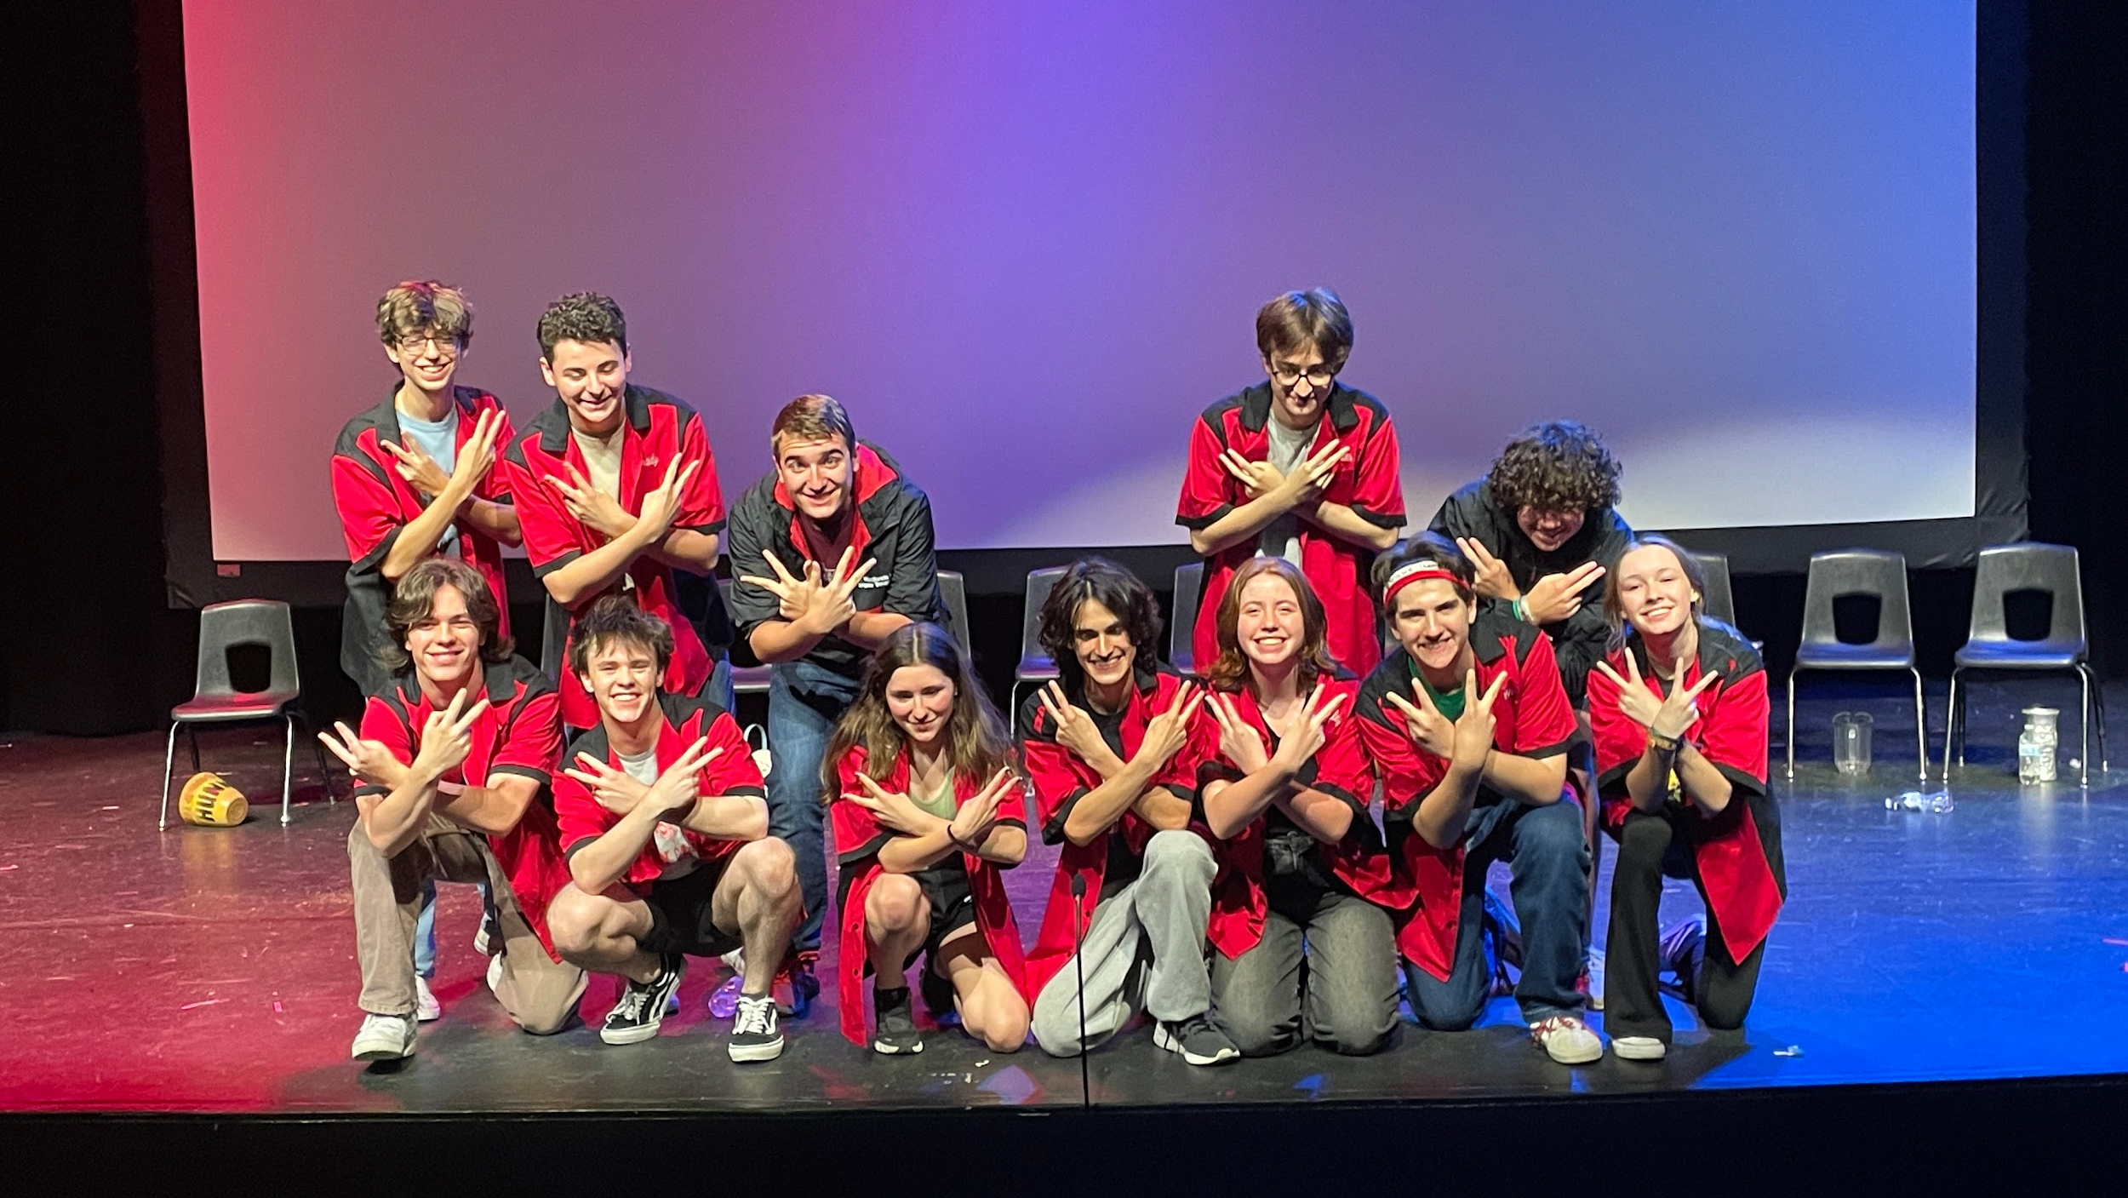
Improv
Monthly shows to support charities!
Raised $21,784 in 2022-2023 school year!
Over $206,000 raised in total!
First show of the year- September 8th, 2023!

Slide 23
Speech!
Grow as a performer
Boost your college applications
Travel with your friends
Meet new people
Win awards and honors

Slide 24
Social Media
Instagram
Snapchat
Facebook
@twhstheater
@twhstroupe1053
@twhstheater
Twitter
Tiktok
Website
@TWHStheater
@twhstheater
www.twhstheater.com

Slide 25
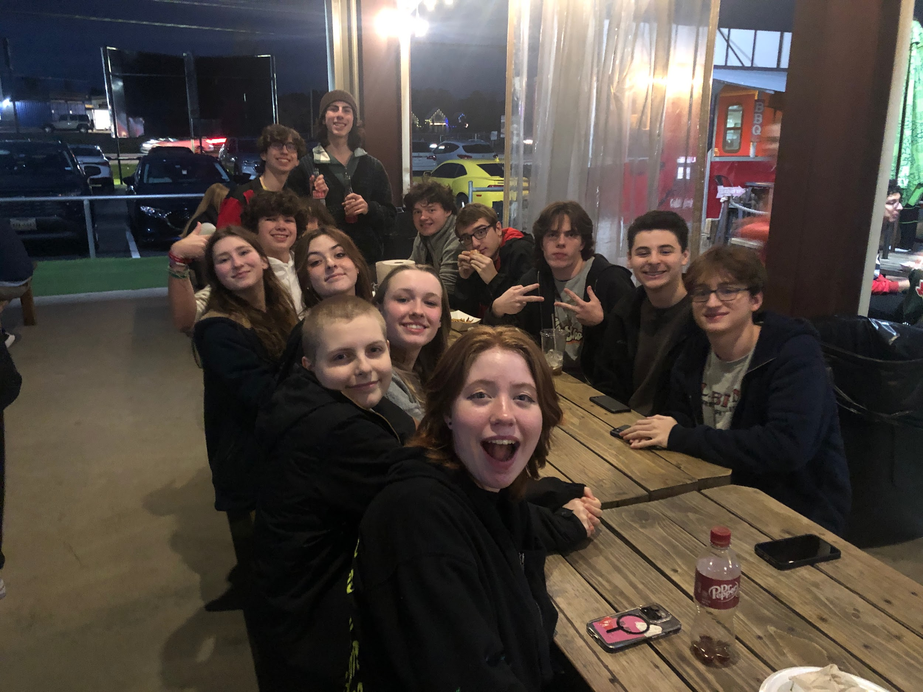
Outings
Why?
What?
We have outings so that every student has chances to bond with the rest of the troupe and to make and strengthen friendships!
Throughout the year we have a variety of outings such as potlucks, sonic nights, pumpkin carving, Ice Skating and more!
Any kids who are involved in the department, want to be involved in the department or just want a good time
For the most part they are sometime after school on Fridays or Saturdays
Who?
When?

Slide 26
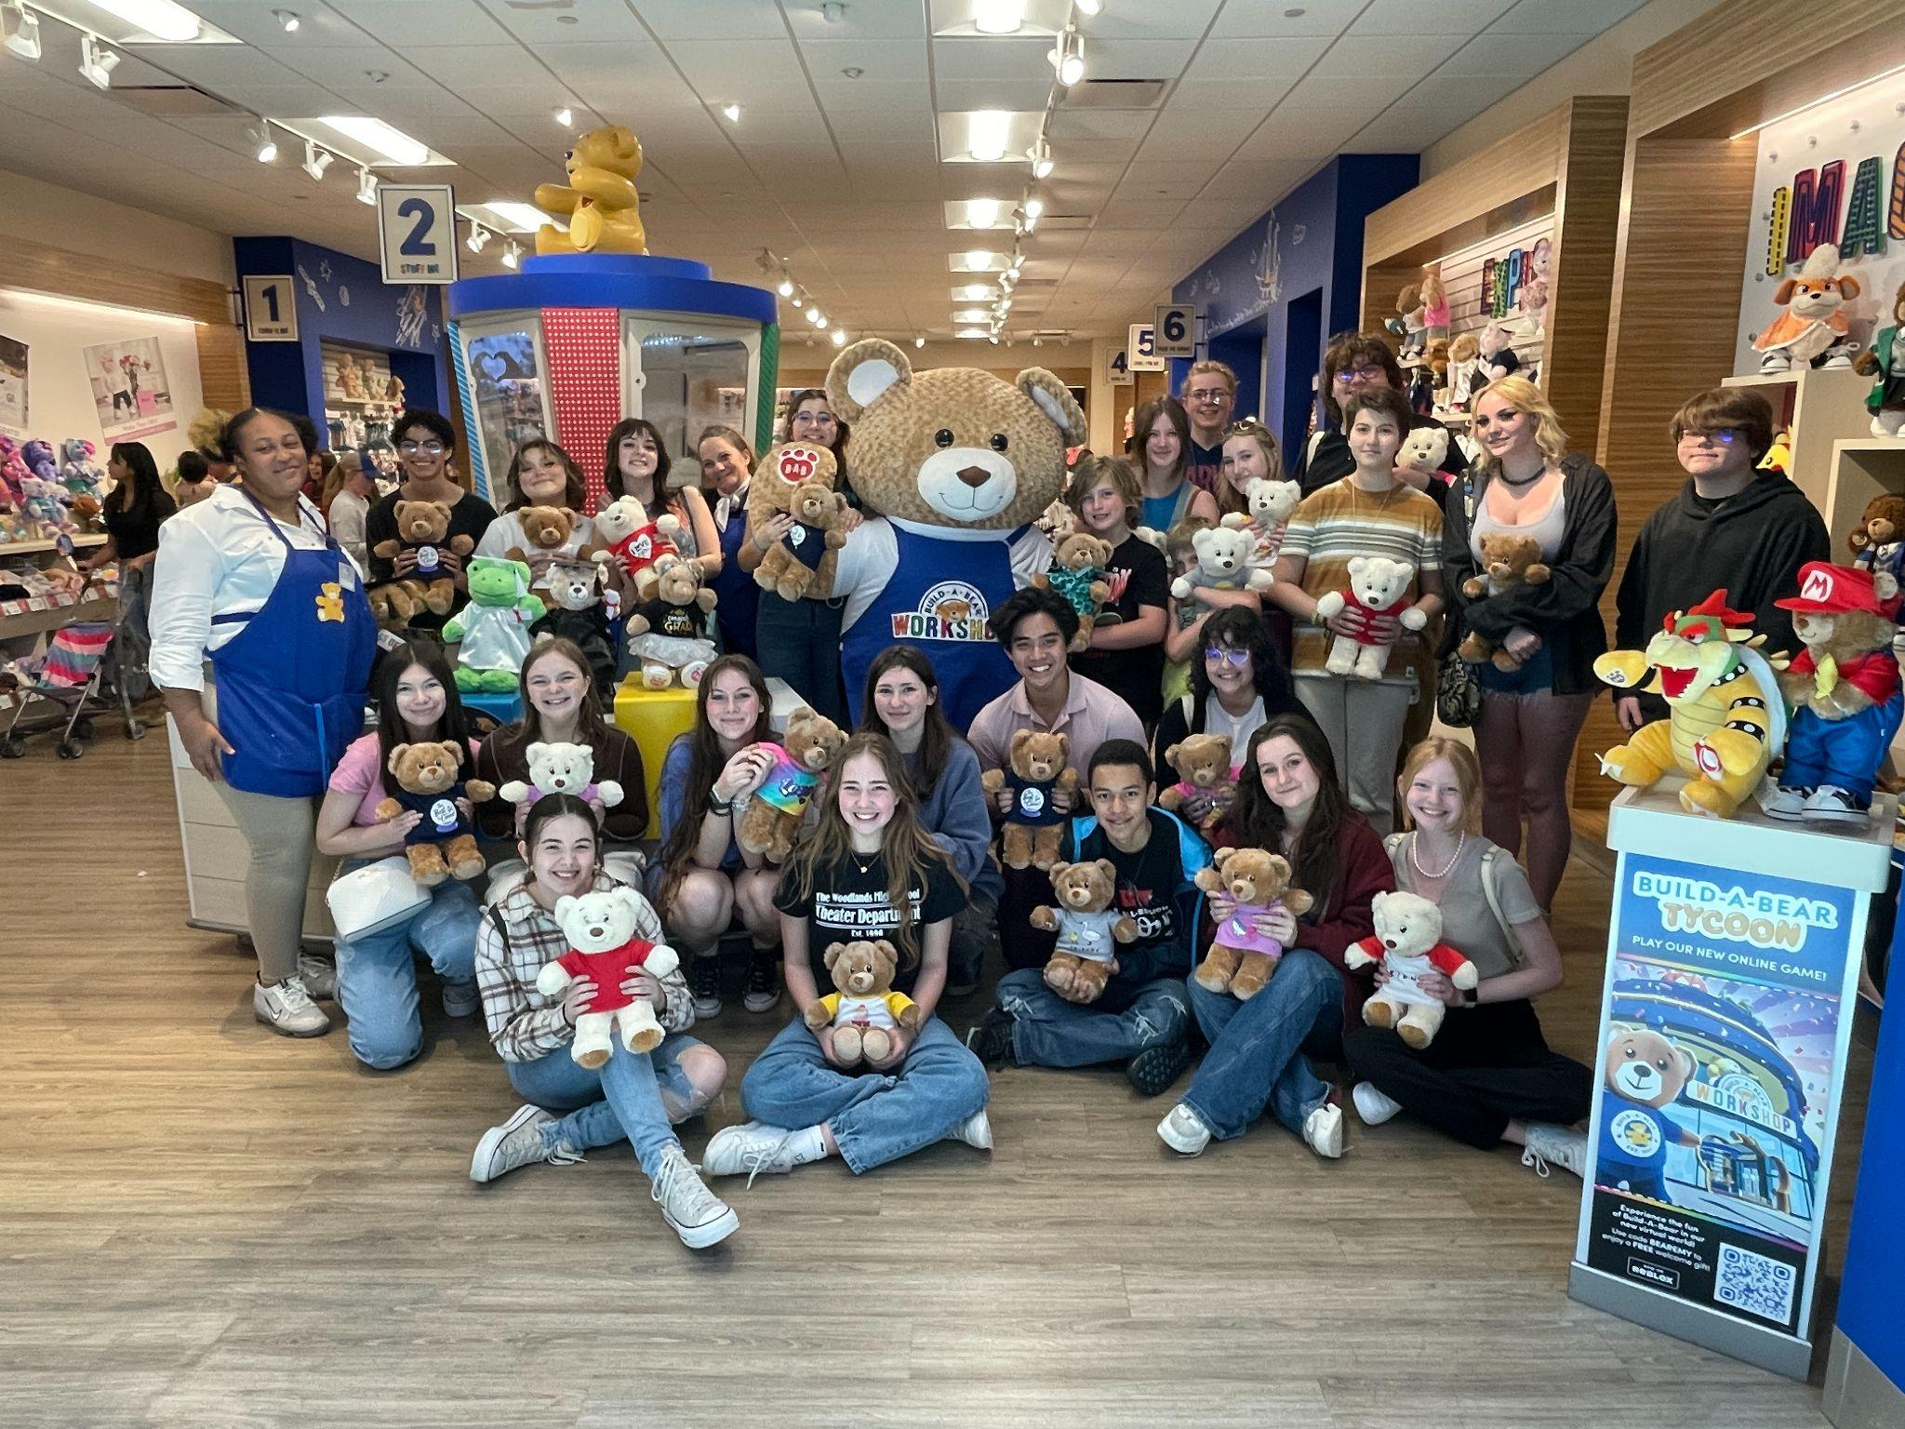
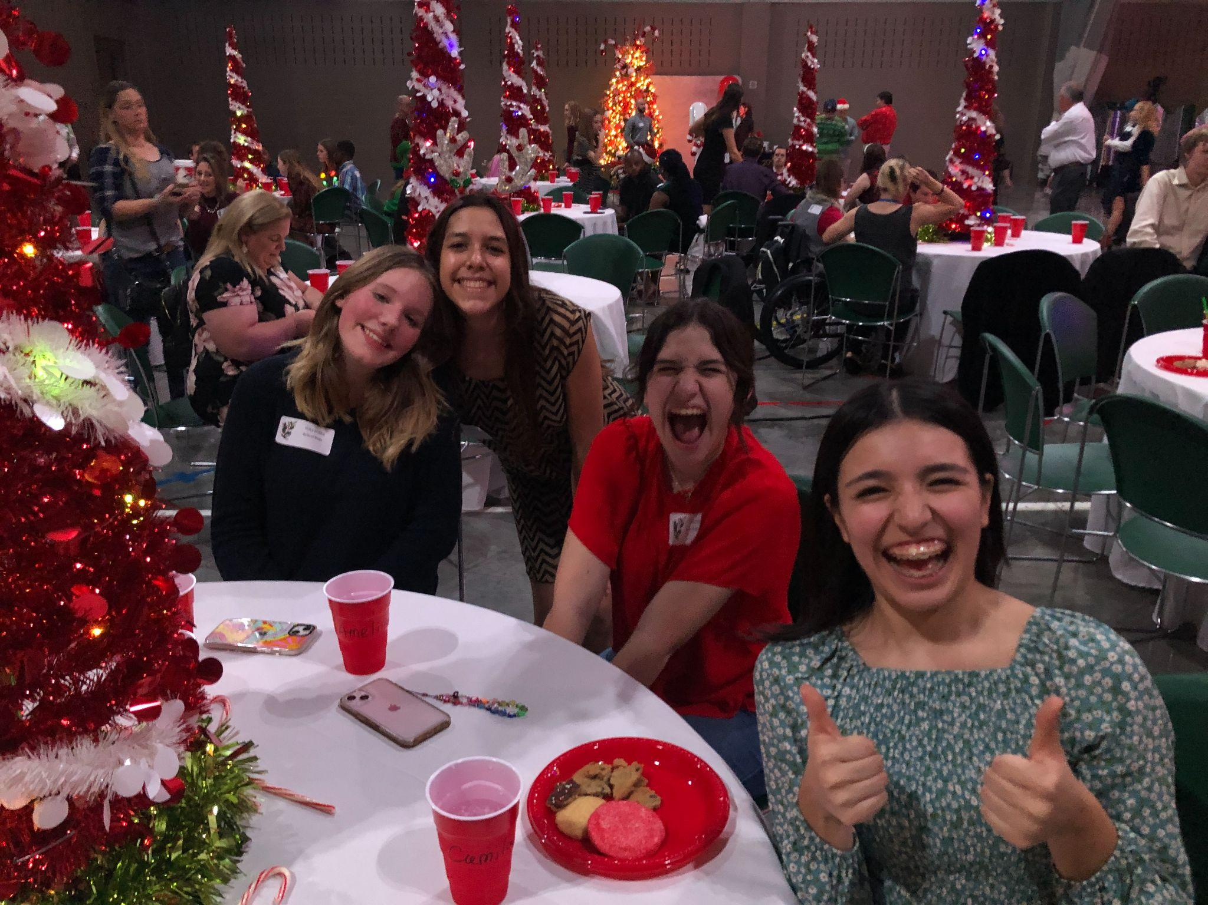
Community Outreach
This Month-
General-
One donation drive and one outing per month
15 items for 1 point, up to 3 points
Any organization ideas?
Book Drive for Student’s Books on Wheels!
Coming Up-
TOTS
Blanket Making for Project Linus

Slide 27
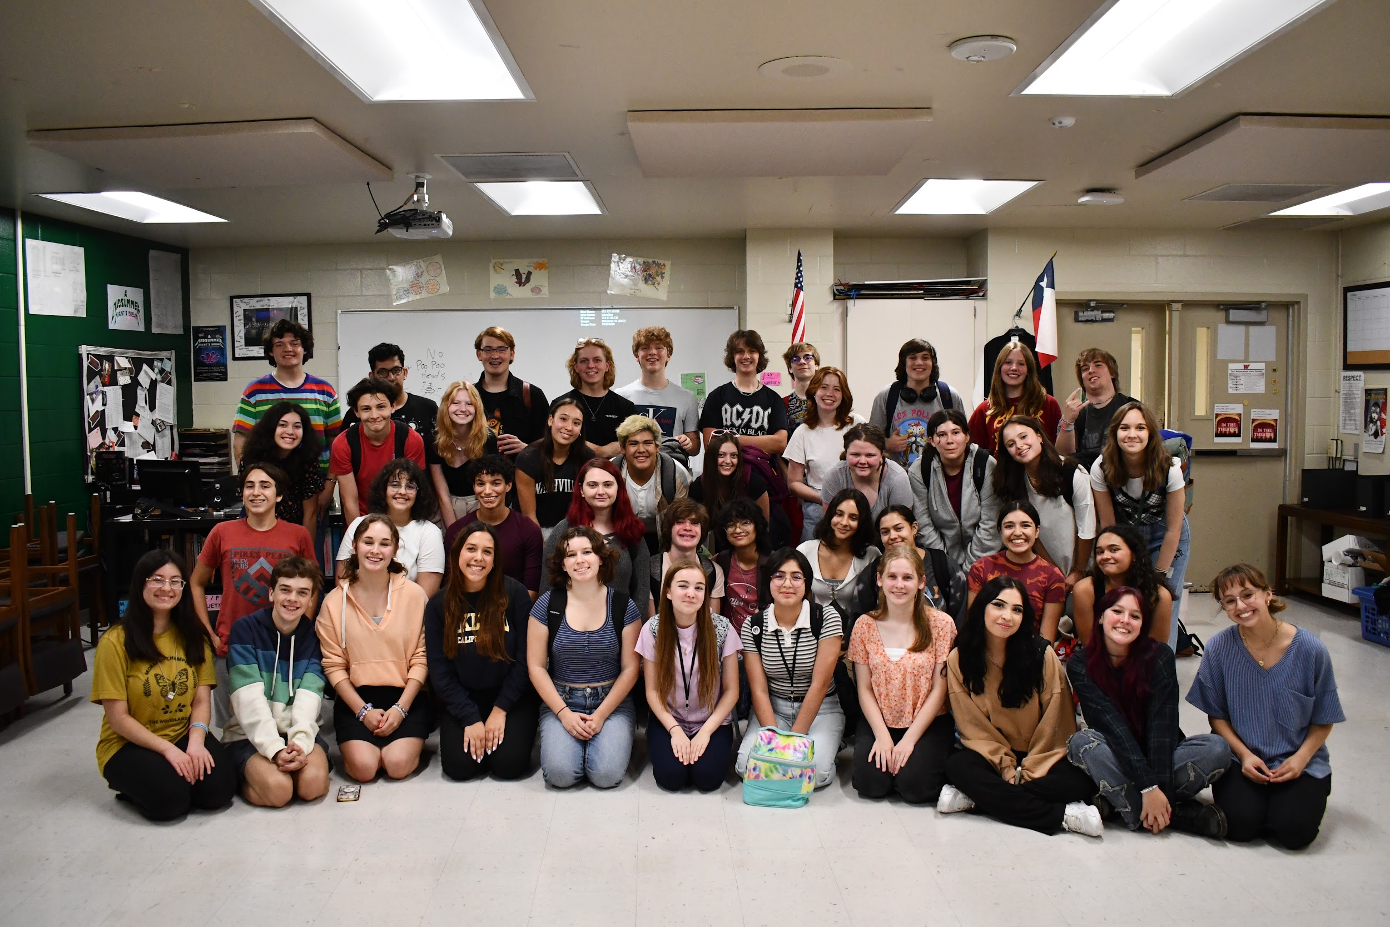
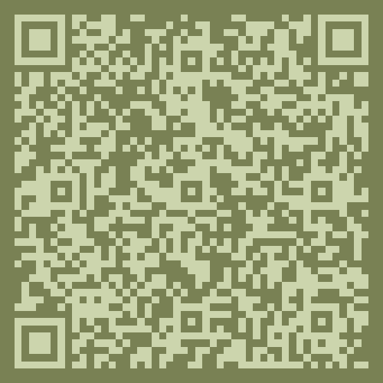
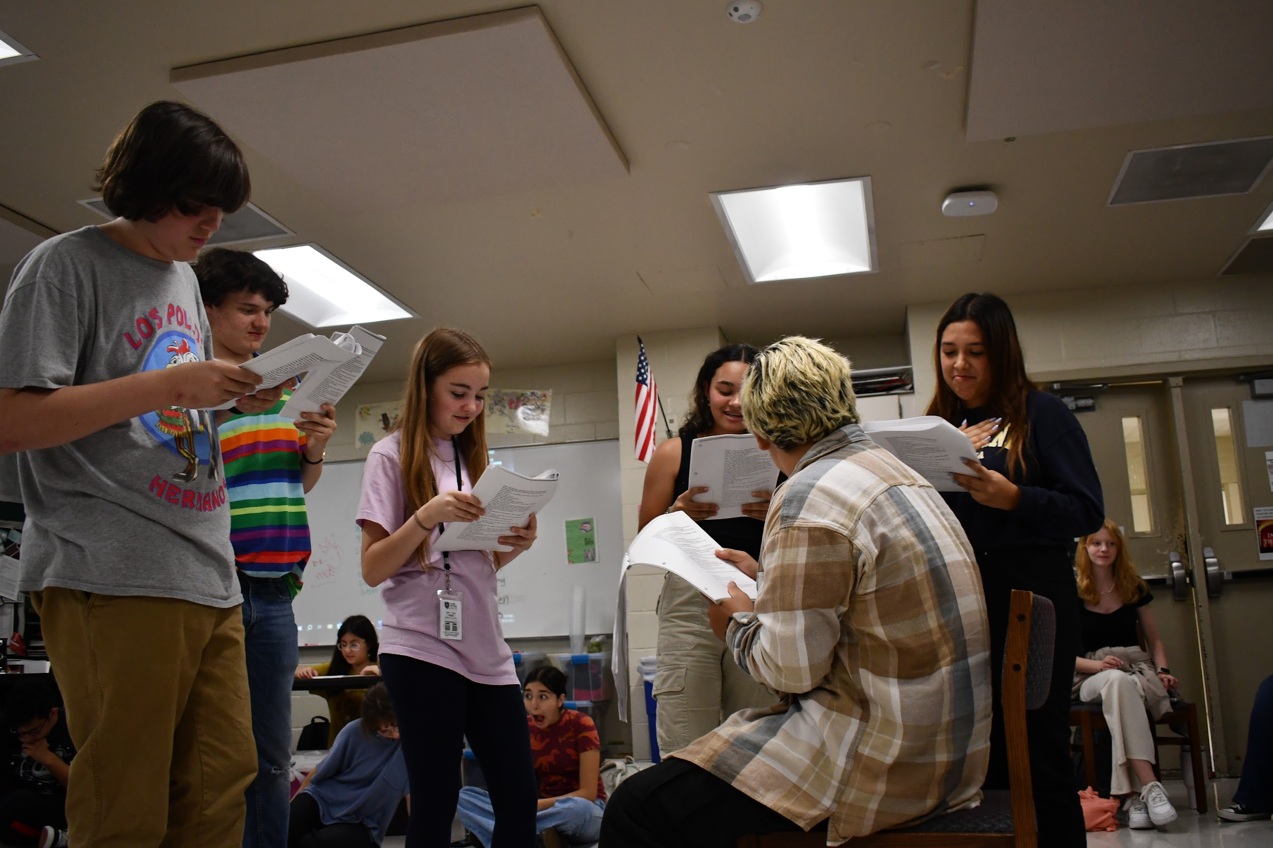
Script Club!
Meets every Wednesday from 3:00-4:15
We read a new script every few weeks!
Great for improving cold reading skills & reading new plays.
Scan the QR code to join our GroupMe!!

Slide 28
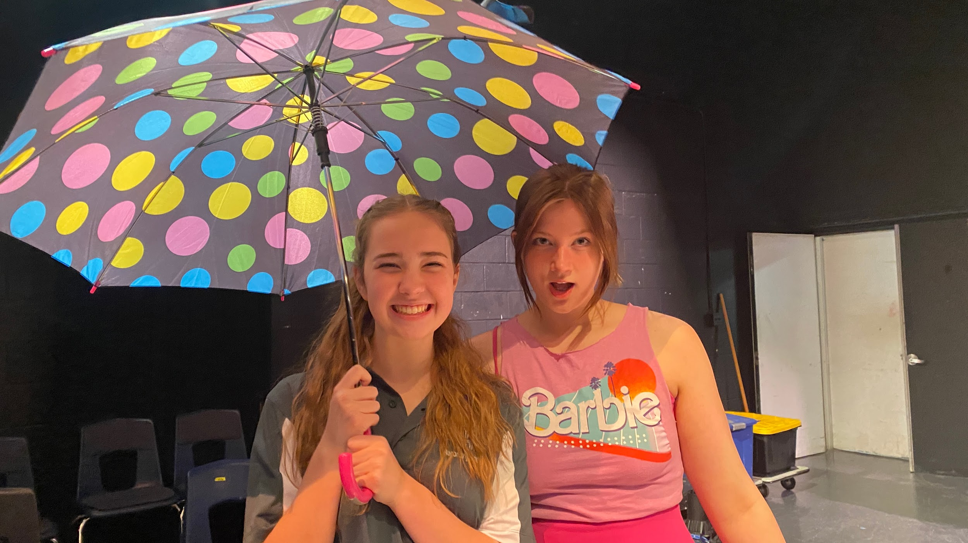
Upcoming Dates!
Improv Show Sept. 8th
Little Women Sept. 21st-23rd
Improv show Oct. 6th
Puffs Oct. 19th-21st
Improv Show Nov. 3rd
Improv Show Dec. 8th
The Sound of Music Jan. 25th-27th

